Slide 1
PROJECT TIME PLANNING Process and Bar Chart Technique

Slide 2
Definition of Planning
Planning is the process of thinking systematically about the future in order to decide
what our goals are, and
how we are going to achieve them.
Planning means looking ahead, making preparations, and deciding the best course of action.

Slide 3
Dimensions of Planning
Planning can be viewed from following points:
Subject:- Financial Planning, Time Planning, Quality Planning, Organizational Planning, …….
Organization:- Corporate Planning, Project Planning,…….
Time:- Long-Rang.Planning, Short-Range Planning, Weekly Planning, ….

Slide 4
Why is Time Planning necessary?
The increasing importance of timely completion.
The continuous complexity and growth in the size of the project generates the necessity for specialization. Specialization may lead to a breakdown of communications. Time planning must be found to facilitate communications.
Planning is essential for resource management and the efficient and maximum utilization of resources.
Planning is basis for evaluating progress, controlling the work and making decisions.

Slide 5
Why is Time Planning necessary?
For achieving an increase in production.
Financiers require a workable plan.
Essential in projects when their is transfer of personnel.
Minimum risk of the problems occurring.

Slide 6
Who Needs Time Planning?
Customer/ Client/ Owner
Designer/ Consultant
Project management team (Manager, Engineers)
Cost estimating department
Planning and controlling department
Supervisors, foremen, labors
Supplier
Financiers

Slide 7
Processes of Time Planning
Visualize and define the activities.
Sequence the activities (Job Logic).
Estimate the activity duration.
Schedule the project or phase.
Allocate and balance resources.

Slide 8
Visualize and define the activities
An activity is a single work step (element) that has a recognizable beginning and end and requires time for its accomplishment. Activity definition involves identifying and documenting the specific activities that must be performed to produce the deliverables and sub-deliverables.
The technique of decomposition (Work Breakdown) may be used in defining activities. Decomposition involves subdividing project work packages into smaller, more manageable components to provide better management control.
The output from activity definition is the activity list.
The Level of detail of the plan should be considered in this phase.

Slide 9
Visualize and define the activities
Case Study: Install a new machine
Activity Code | Activity Description | Depends on | Level | Duration (day)
 | Inspect the machine after installation
 | Hire the operator
 | Install the new machine
 | Inspect and store the machine after delivery
 | Hire labor to install the new machine
 | Train the operator
 | Order and deliver the new machine

Slide 10
Sequence the activities
Sequence the activities or job logic refers to identifying and documenting interactivity logical relationships, i.e. determined order in which the activities are to be accomplished in the project.
Job plan must reflect the practical restraints or limitations that apply to most job activities. The types of restraints are:
Mandatory dependencies or hard logic (natural dependency),
Preferred logic (Discretionary dependencies),
External dependencies,
Resource restraints and
Safety restraints.
Predecessor activities mean coming before, while successor activities mean coming after.
Overlap the activities to reduce the project time.

Slide 11
Sequence the activities
Activity Code | Activity Description | Depends on | Level | Duration (day)
 | Order and deliver the new machine | None | 1
 | Hire the operator | None | 1
 | Hire labor to install the new machine | None | 1
 | Inspect and store the machine after delivery | Order and deliver the new machine | 2
 | Install the new machine | Hire labor to install the new machine Inspect and store the machine after delivery | 3
 | Train the operator | Install the new machine Hire the operator | 4
 | Inspect the machine after installation | Install the new machine | 4
11
2/14/2017 12:46 PM

Slide 12
Sequence the activities
Case Study: Install a new machine
Activity Code | Activity Description | Depends on | Level | Duration (day)
100 | Inspect the machine after installation | 300 | 4
200 | Hire the operator | None | 1
300 | Install the new machine | 500, 400 | 3
400 | Inspect and store the machine after delivery | 700 | 2
500 | Hire labor to install the new machine | None | 1
600 | Train the operator | 200, 300 | 4
700 | Order and deliver the new machine | None | 1

Slide 13
Estimate the activity duration
Select the time unit (week, day,..) to be used.
Use one of the following tools and techniques for estimating the activity duration:
Expert judgment
Quantitatively based durations
Duration of activity (D)
= Quantity of work / [Production rate of a crew or equipment * No. of crews].
Where production rate = Quantity produced in unit of time
Duration of activity (D)
= Quantity of work * Unit rate productivity of a crew or equipment
Where unit rate productivity = Time needs to produce one unit of output

Slide 14
Estimate the activity duration
Case Study: Install a new machine
Activity Code | Activity Description | Depends on | Level | Duration (day)
100 | Inspect the machine after installation | 300 | 4 | 1
200 | Hire the operator | None | 1 | 25
300 | Install the new machine | 500, 400 | 3 | 2
400 | Inspect and store the machine after delivery | 700 | 2 | 1
500 | Hire labor to install the new machine | None | 1 | 20
600 | Train the operator | 200, 300 | 4 | 3
700 | Order and deliver the new machine | None | 1 | 30

Slide 15
Schedule the Project or Phase
Scheduling is the determination of the project time and the timing of the activities comprising the project.
In scheduling we consider the questions of
how long the project is expected to take and
when each activity may be scheduled (started and ended)
To schedule the project, the planner needs a Time Planning Technique.

Slide 16
Time Planning Techniques
Practically every project is sufficiently complex that its breakdown and its inner relationships must be recorded on paper or other media, and not only in the head of the planner.
Therefore as a plan is formulated some type of "paper model" of the project should be developed to communicate results of the plan to others and to serve as a basis for evaluating progress and controlling the work.

Slide 17
Time Planning Techniques
Bar Charts and Linked Bar Charts;
Network Model (Analysis), either
Activity on arrow,
Activity on node,
Precedence Diagram
Line of Balance;
Time-location Diagram.

Slide 18
BAR CHART
During World War 1, Henry Gantt developed the Bar chart planning technique.
A bar chart graphically describes a project consisting of well-defined activities, the completion of which marks its end.
An activity is a task whose performance contributes to completion of the overall project.

Slide 19
BAR CHART
All activities are listed in a column at the left side of the diagram.
A horizontal time scale extends to the right of the list.
A bar presenting each activity is drawn between its corresponding scheduled start and finish times.

Slide 20
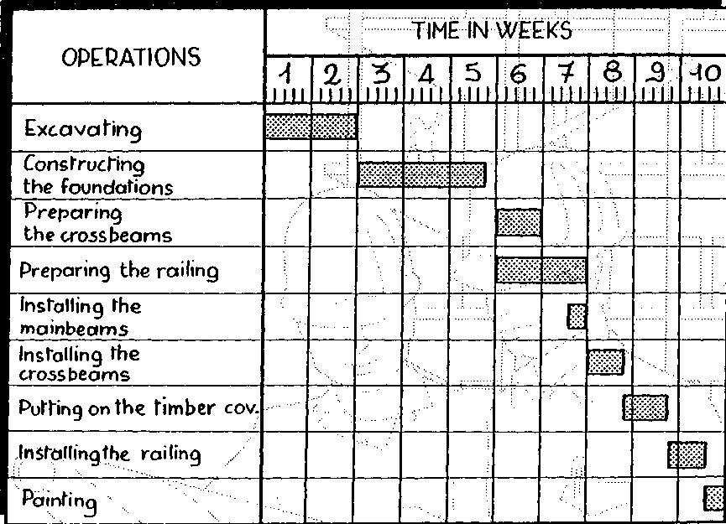
Preparing a Bar Chart

Slide 21
Uses of Bar Chart Planning Technique
Showing the order of the different activities
Showing when operations should start and finish
Checking what labor or equipment are needed and when
Checking out delivery dates for materials
Explaining to everyone concerned what is due to happen and when
Forecasting cash flow
During execution, the chart used to control the work

Slide 22
Advantages of Bar Chart
Simple graphical form
Easy understood for all levels of management
Good form of communication.

Slide 23
Limitations of Bar Chart
Very cumbersome as the number of activities, increases
Logic is not expressed in the diagram
Difficult to use it for forecasting the effects of changes, It is therefore limited as control tool
No indication where management attention should be focused
Ineffective for project shortening

Slide 24
Logic is not represented in the Bar Chart

Slide 25
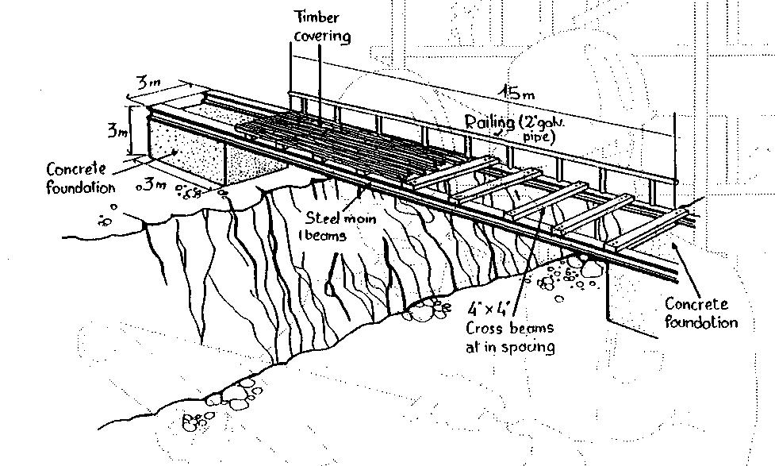
Case study

Slide 26
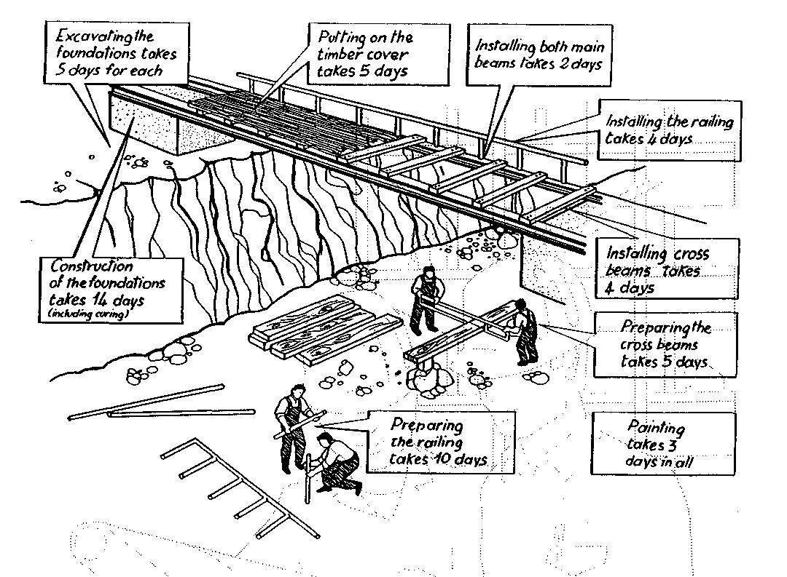
Case study

Slide 27
Preparing a Bar Chart

Slide 28
Gantt Chart
Visual scheduling tool
Graphical representation of information
Show dependencies between tasks, personnel, and other resources allocations
Track progress towards completion

Slide 29
Building a Gantt Chart
List all tasks and milestones from the project along the vertical axis
List time frame along the horizontal axis
Activity 1
Activity 2
Milestone
Time Frame: day 1 day 2 day3

Slide 30
Building a Gantt Chart
Activities: Create box the length of each activity time duration
E.g., activity one is scheduled from day1-day3
Activity 1
Activity 2
Time Frame: day 1 day 2 day3

Slide 31
Building a Gantt Chart
Dependencies: Show dependencies between activities with arrows
E.g., activity 2 cannot start until activity 1 is complete
Activity 1
Activity 2
Time Frame: day 1 day 2 day3…

Slide 32
Sequence of Activities of The Project - House Building
Number | Activity | Predecessor | Duration
1 | Design house and obtain financing | -- | 3 months
2 | Lay foundation | 1 | 2 months
3 | Order and receive materials | 1 | 1 month
4 | Build house | 2,3 | 3 months
5 | Select paint | 2, 3 | 1 month
6 | Select carper | 5 | 1 month
7 | Finish work | 4, 6 | 1 month

Slide 33
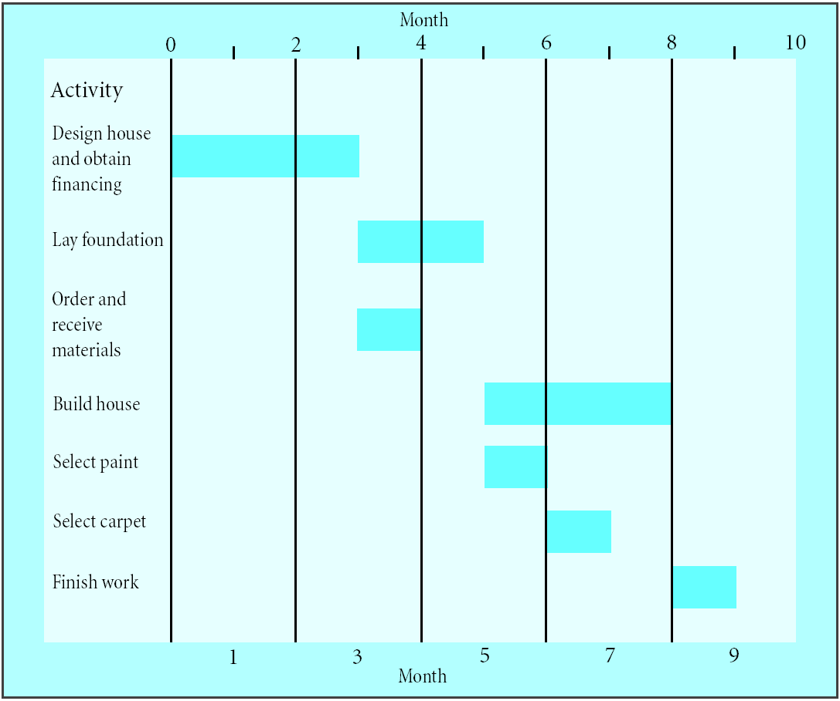
Gantt Chart for House Building Project
A Gantt chart

Slide 34
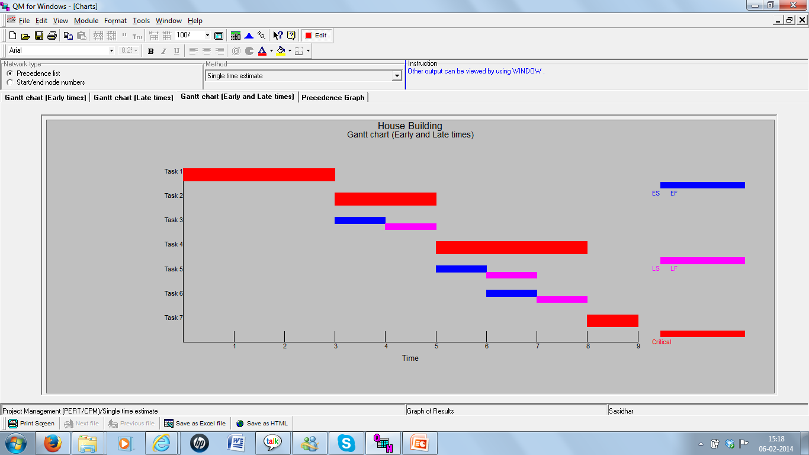
Gantt Chart for House Building Project using QM for Windows

Slide 35
Gantt Charts
Establish a time-phased network
Can be used as a tracking tool
Benefits of Gantt charts
Easy to create and comprehend
Identify the schedule baseline network
Allow for updating and control
Identify resource needs

Slide 36
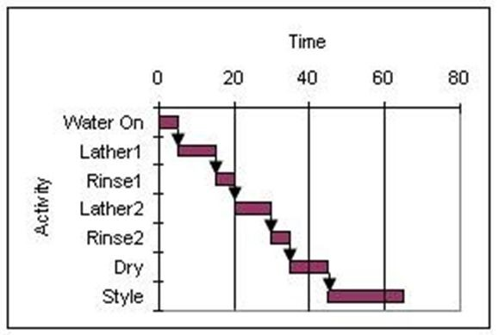
Gantt Charts – Example
Consider the Gantt chart shown below where the time scale is in minutes and all activities are performed on an early start basis. How much slack is available in the project?
Answer: Nil

Slide 37
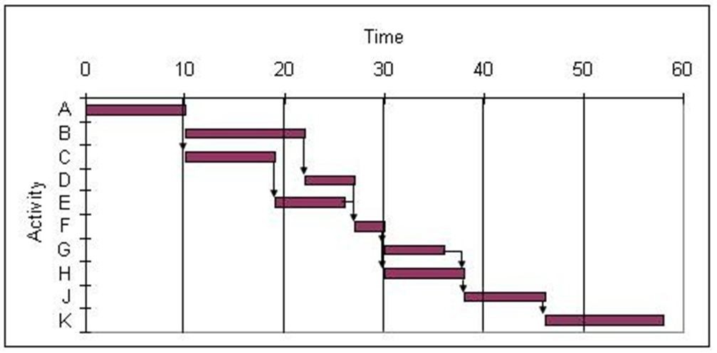
Gantt Charts – Resource Allocation Example
Use the Gantt chart and the activity list to determine when resource 5 is free.
Activity | Resources | Activity | Resources
A | 1 | F | 1
B | 5 | G | 2
C | 4 | H | 5
D | 3 | J | 3
E | 2 | K | 4
A) between 0 and 15
B) between 15 and 30
C) between 30 and 45
D) between 45 and 60
Answer: D

Slide 38
Gantt Charts – Resource Allocation Example
Use the Gantt chart and the activity list to determine when resource 2 is free.
Activity | Resources | Activity | Resources
A | 1 | F | 1
B | 5 | G | 2
C | 4 | H | 5
D | 3 | J | 3
E | 2 | K | 2
A) between 0 and 15
B) between 15 and 30
C) between 30 and 45
D) between 45 and 60
Answer: A

